Slide 1
Project
HR Analytics

Slide 2
Group Details & Mentor
Mentor – Bidhan sen
Guide – Suraj kumar
1) Chaitanya Dakhale
2) Niteen Rokade
3) Miss. Maddela Shivani
4) Abhishek Pawar

Slide 3
HR analytics helps to optimize mechanism behind HRM value chain
by allowing us to find answers to certain key questions, such as…
• Which channels bring us the best candidates.
• What characteristics differentiate successful candidates from unsuccessful ones.
• What factors contribute to successful onboarding.
• Which KPIs have the strongest link to the company’s financial results.
• Which training sessions are most likely to lead to improvement of work performance.
• Which interventions have the biggest impact on well-being or work-life balance
perceived by employees.
• What increases or decreases the employees’ engagement level.
• Who represents hidden talent that needs to be detected and further developed.
• Where can resistance be expected with respect to planned changes in the company
and who can instead be their ambassador or catalyst.
• Which factors contribute to employee turnover.
• etc
HR Agenda

Slide 4
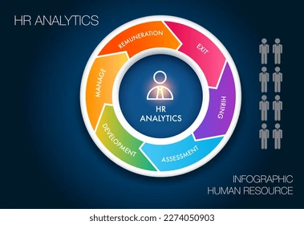
Introduction of HR Domain
HR analytics, also referred to as people analytics, workforce analytics, or talent analytics, involves gathering together, analyzing, and reporting HR data. It enables your organization to measure the impact of a range of HR metrics on overall business performance and make decisions based on data.

Slide 5
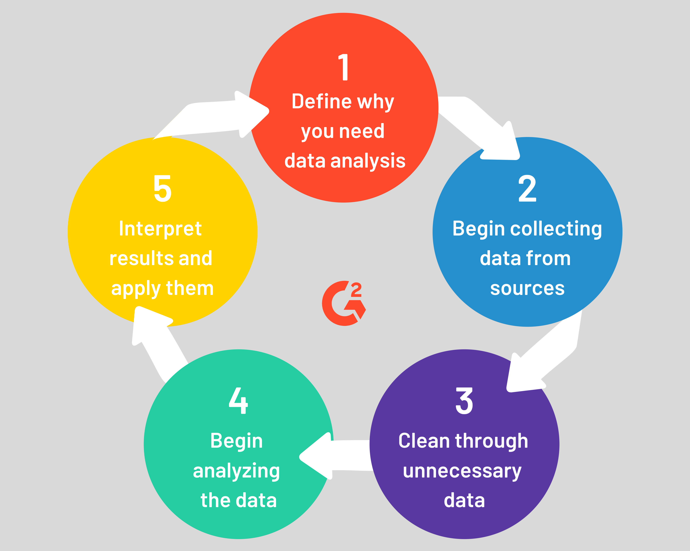
Data Analysis Process And Tools used
The data analysis process is a collection of steps required to make sense of the available data. Identifying the critical stages in a data analysis process is a no-brainer. However, each step is equally important to ensure that the data is analyzed correctly and provides valuable and actionable information. Let's take a look at the five essential steps that make up a data analysis process flow.

Slide 6




Tools used
MS excel
Power BI
Tableau
SQL
After the collection of Data MS excel and adv
Excel are used for basic modelling and
And cleaning of data where excess and
Null data is cleaned and tables are sent to
Microsoft Power BI or tableau to visualize
The data in an order and retrieve meaningful
Insights.

Slide 7
Business objectives
What are the objectives and goals of employee retention ?
The employee retention objectives and goals include a wide variety of targets, designed specifically to make the working experience beneficial and smooth sailing for both employers and employees. It instils a sense of loyalty in the employees, which in turn, adds to growth of the company. Successful companies often have a laid-out framework to achieve maximum employee retention, which not only saves them resources and turnover costs, but also helps in building a network of self-driven and talented employees. Such employees thus have the motivation to take on specialised and expansive projects, and work in line with the company culture
Objectives and Goals of Employee Retention
1. To Reduce Turnover Hassles
2. To Reduce Acquisition and Training Time
3. To Improve Employee Morale
4. To achieve Increased Employee Productivity
5. To achieve Improved Customer Experiences

Slide 8
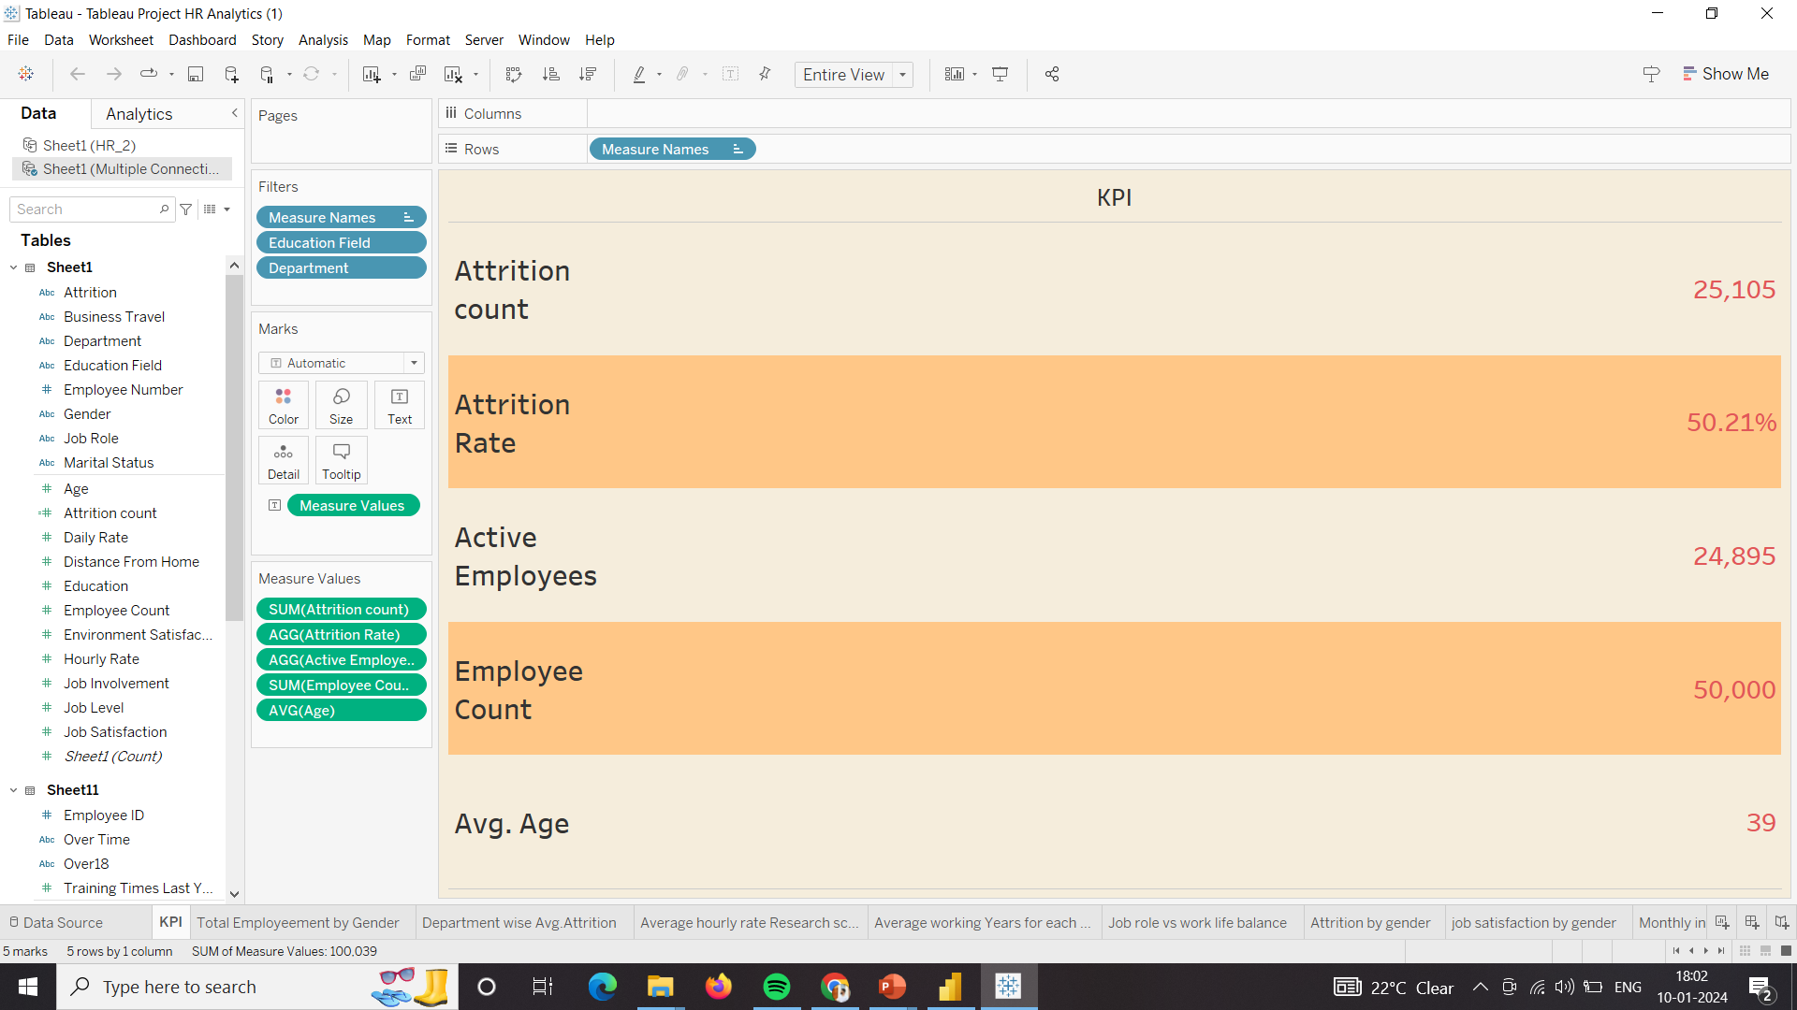
KPI Charts and Their insights

Slide 9
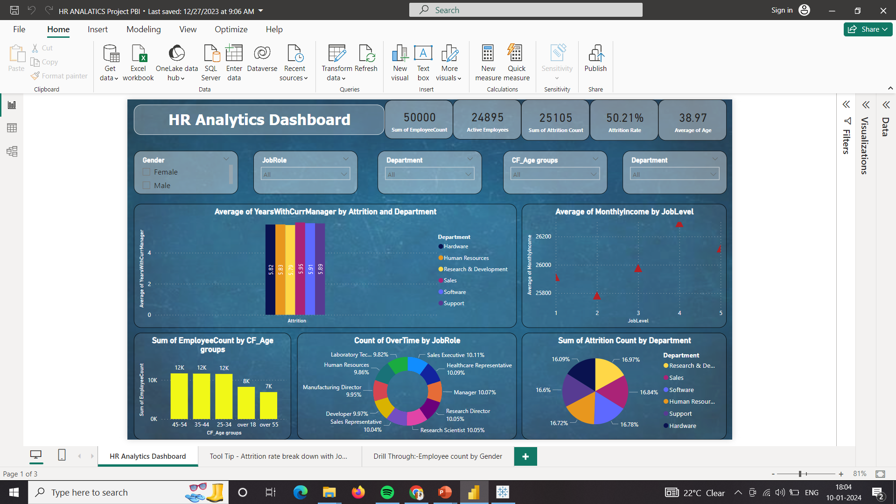
Dashboard

Slide 10
Challenges, lessons, and conclusion
Average Years with Current Manager by attrition and department
Challenge: The challenge is retaining employees even with the stability provided by longer average years with the current manager. Understanding the factors contributing to attrition despite stable managerial relationships is crucial.
Lesson 1: The data suggests that employee needs and motivations might vary despite stable managerial relationships. Conducting in-depth surveys or interviews to uncover individual preferences and concerns contributing to attrition.
Lesson 2: While stability is reflected in average years with the current manager, there's a lesson in balancing this stability with opportunities for employee growth. Develop professional development programs and career advancement opportunities to align with employee aspirations.
Conclusion: The challenge of retaining employees despite longer average tenures highlights the complexity of retention efforts.
The varied employee needs indicate a need for individualized retention approaches. Customizing retention initiatives based on the unique preferences and concerns identified through employee feedback will improve retention rate.
Retention efforts should involve continuous monitoring and adaptation. Establishing a feedback loop to monitor the effectiveness of retention strategies and adapting them as needed to align with evolving employee expectations.

Slide 11
Avg of Monthly income by job level
Challenge : Balancing the desire for competitive compensation with budgetary constraints. Ensuring that salary structures align with both organizational financial capabilities and industry standards.
Lesson : The data provides insights into the compensation expectations at different job levels. Using this we can understandand align compensation structures with industry benchmarks and employee expectations.
Conclusion: Regular reviews of compensation structures are necessary to adapt to changing market conditions and organizational priorities.
Conducting periodic reviews to ensure that compensation remains competitive and fair across job levels.
Aligning compensation with career growth opportunities can contribute to employee satisfaction.

Slide 12
Sum of Employee count by age group
Challenge: Balancing age diversity in the workforce can be challenging, especially with varying counts across different age groups. Creating an inclusive environment that values the contributions of employees across different age brackets is essential.
Ensuring effective succession planning considering the age distribution.Preparing for potential retirements and promoting knowledge transfer becomes crucial for organizational continuity.
Lesson1 : Tailoring employee programs to cater to different age groups' needs can enhance engagement.
Develop benefits and programs that address the diverse needs of employees at various stages of their careers.
Lesson 2: With a significant count in the over 55 age group, implementing knowledge transfer strategies is vital.
Establish mentorship programs and knowledge-sharing initiatives to pass on valuable expertise to younger employees.
Conclusion: Fostering a culture of continuous learning is essential for employees of all age groups.
Invest in training and development programs that cater to various career stages, promoting ongoing skill enhancement.
Considering the age distribution, health and wellness programs become increasingly important.
Implement wellness initiatives that address the specific health needs of employees in different age groups.

Slide 13
Count of over time by job role
Challenge: Identifying disparities in overtime distribution among different job roles.
Ensuring fair workload distribution and preventing burnout in specific roles to enhance overall well-being.
Lesson: Recognizing that certain job roles inherently require more overtime.
Tailor workload expectations and support mechanisms based on the nature of each job role.
Conclusion: Ensuring fair and equitable distribution of workloads, taking into account overtime counts.
Review workload distribution strategies and adjust as needed to prevent excessive overtime in specific roles.
Ensuring fair and equitable distribution of workloads, taking into account overtime counts.
Review workload distribution strategies and adjust as needed to prevent excessive overtime in specific roles.
Recognizing the importance of employee well-being in roles with high overtime counts.
Introduce well-being initiatives, such as mental health support and stress management programs, to support employees in demanding roles

Slide 14
Attrition count by department
Challenge: Addressing the challenge of consistently high attrition rates in each department.
Identifying the root causes of attrition and implementing strategies for retention.
Managing the potential impact of high attrition on team dynamics and overall morale.
Maintaining a positive and productive work environment despite turnover challenges.
Lesson: Recognizing the specific factors contributing to high attrition rates in each department.
Conduct detailed exit interviews and surveys to understand employee concerns and reasons for leaving.
Lesson: Tailoring retention strategies based on department-specific challenges.
Develop and implement targeted retention programs that address the unique needs and concerns of each department.
Conclusion: Developing and implementing department-specific retention plans.
Establish customized retention initiatives for each department, considering the unique challenges and requirements.
Implementing continuous monitoring mechanisms to track attrition rates.
Regularly review and adjust retention strategies based on evolving departmental needs and employee feedback.
Recognizing the importance of employee engagement in reducing attrition.
Invest in initiatives that enhance employee engagement, such as professional development programs, mentorship, and recognition.

Slide 15
Thank You

